Slide 1

Control Flow Statements
Presented By:-Siburanjan Samal

Slide 2
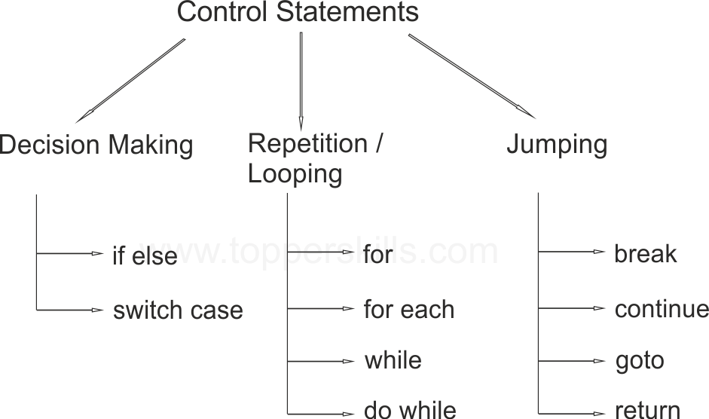
PROGRAM CONTROL STATEMENTS/CONSTRUCTS IN ‘C’

Slide 3

WHY DO WE NEED TO LEARN CONTROL STATEMENTS ?
Understanding meaning of a statement and statement block.
Learn about decision type control constructs in C and the way these are used.
Learn about looping type control constructs in C and the technique of putting them to use.
Learn the use of special control constructs such as goto, break, continue, and return.
Learn about nested loops and their utility.

Slide 4
if syntax:-
if (condition) | if (condition)
statement; | { statements; }
next_statement; | next_statement;
1. (condition) is evaluated. 2. If TRUE (non-zero) the statement is executed. 3. If FALSE (zero) the next_statement following the if statement block is executed. 4. So, during the execution, based on some condition, some codes were skipped.

Slide 5
if-else syntax:-
if (condition) | if (condition)
statement_1; | { a block of statements; }
else | else
statement_2; | { a block of statements; }
next_statement; | next_statement;
1. The (condition) is evaluated. 2. If it evaluates to non-zero (TRUE), statement_1 is executed, otherwise, if it evaluates to zero (FALSE), statement_2 is executed. 3. They are mutually exclusive, meaning, either statement_1 is executed or statement_2, but not both. 4. statements_1 and statements_2 can be a block of codes and must be put in curly braces.

Slide 6
if-else-if syntax:-
if(condition_1)
statement_1;
else if (condition_2)
statement_2;
else if(condition_3)
statement_3;
else
statement_4;
next_statement;

Slide 7
switch case syntax:-
switch(condition)
{
case template_1 : statement(s);
break;
case template_2 : statement(s);
break;
case template_3 : statement(s);
break;
…
…
case template_n : statement(s);
break;
default : statement(s);
}
next_statement;

Slide 8
for loop syntax:-
for(initial_value;condition(s);increment/decrement)
statement(s);
next_statement;
initial_value, condition(s) and increment/decrement are any valid C expressions. The statement(s) may be a single or compound C statement (a block of code). When for statement is encountered during program execution, the following events occurs: 1. The initial_value is evaluated e.g. intNum = 1. 2. Then the condition(s) is evaluated, typically a relational expression. 3. If condition(s) evaluates to FALSE (zero), the for statement terminates and execution passes to next_statement. 4. If condition(s) evaluates as TRUE (non zero), the statement(s) is executed. 5. Next, increment/decrement is executed, and execution returns to step no. 2 until condition(s) becomes FALSE.

Slide 9
The while loop syntax:-
while (condition)
statement(s);
next_statement;
The (condition) may be any valid C expression. The statement(s) may be either a single or a compound (a block of code) C statement. When while statement encountered, the following events occur: 1. The (condition) is evaluated. 2. If (condition) evaluates to FALSE (zero), the while loop terminates and execution passes to the next_statement. 3. If (condition) evaluates as TRUE (non zero), the C statement(s) is executed. 4. Then, the execution returns to step number 1 until condition becomes FALSE.

Slide 10
The do-while loop syntax:-
do
statement(s);
while (condition)
next_statement;
(condition) can be any valid C expression. statement(s) can be either a single or compound (a block of code) C statement. When the program encounter the do-while loop, the following events occur: 1. The statement(s) are executed. 2. The (condition) is evaluated. If it is TRUE, execution returns to step number 1. If it is FALSE, the loop terminates and the next_statement is executed. 3. This means the statement(s) in the do-while will be executed at least once.

